Slide 1
INFORMATION
AS A SERVICE

Slide 2
PROFESSIONALS
TECHNOLOGY
INFORMATION
SERVICES
PLACES

Slide 3
VALUE

Slide 4
VALUE
FASTER
SMARTER

Slide 5
SKILLS
VALUE
FASTER
SMARTER

Slide 6
SKILLS
VALUE
FASTER
SMARTER
COLLECTIONS RESOURCES

Slide 7
SKILLS
VALUE
FASTER
SMARTER
COLLECTIONS RESOURCES
USER EXPERIENCE

Slide 8
SKILLS
VALUE
FASTER
SMARTER
COLLECTIONS RESOURCES
USER EXPERIENCE
EASY PLEASURABLE

Slide 9
SKILLS
VALUE
FASTER
SMARTER
COLLECTIONS RESOURCES
PROCESS
USER EXPERIENCE
EASY PLEASURABLE

Slide 10
SKILLS
VALUE
FASTER
SMARTER
COLLECTIONS RESOURCES
PROCESS
USER EXPERIENCE
EASY PLEASURABLE
PEOPLE

Slide 11
SKILLS
EDUCATION + QUALIFICATIONS
FASTER
SMARTER
COLLECTIONS RESOURCES
PROCESS
EASY PLEASURABLE
PEOPLE

Slide 12
SKILLS
EDUCATION + QUALIFICATIONS
FASTER
SMARTER
COLLECTIONS RESOURCES
DEVELOPMENT + MANAGEMENT
PROCESS
EASY PLEASURABLE
PEOPLE

Slide 13
SKILLS
EDUCATION + QUALIFICATIONS
FASTER
SMARTER
COLLECTIONS RESOURCES
DEVELOPMENT + MANAGEMENT
PROCESS
PROTECTION + ACCESS
EASY PLEASURABLE
PEOPLE

Slide 14
SKILLS
EDUCATION + QUALIFICATIONS
FASTER
SMARTER
COLLECTIONS RESOURCES
DEVELOPMENT + MANAGEMENT
PROCESS
PROTECTION + ACCESS
EASY PLEASURABLE
PEOPLE
TASK + SERVICE

Slide 15
SKILLS =
ONGOING LEARNING

Slide 16
SKILLS =
ONGOING LEARNING
ACCESS =
NEGOTIATION

Slide 17
SKILLS =
ONGOING LEARNING
ACCESS =
NEGOTIATION
PROCESS =
COLLABORATION

Slide 18
SKILLS =
ONGOING LEARNING
ACCESS =
NEGOTIATION
FUNDING =
FAIR
PROCESS =
COLLABORATION

Slide 19
We’re pulling our advocacy together into one powerful campaign

Slide 20
for greater impact,
more supporters,
more engagement,
more exposure.

Slide 21
Be part of it.
Join FAIR.

Slide 22


Slide 23
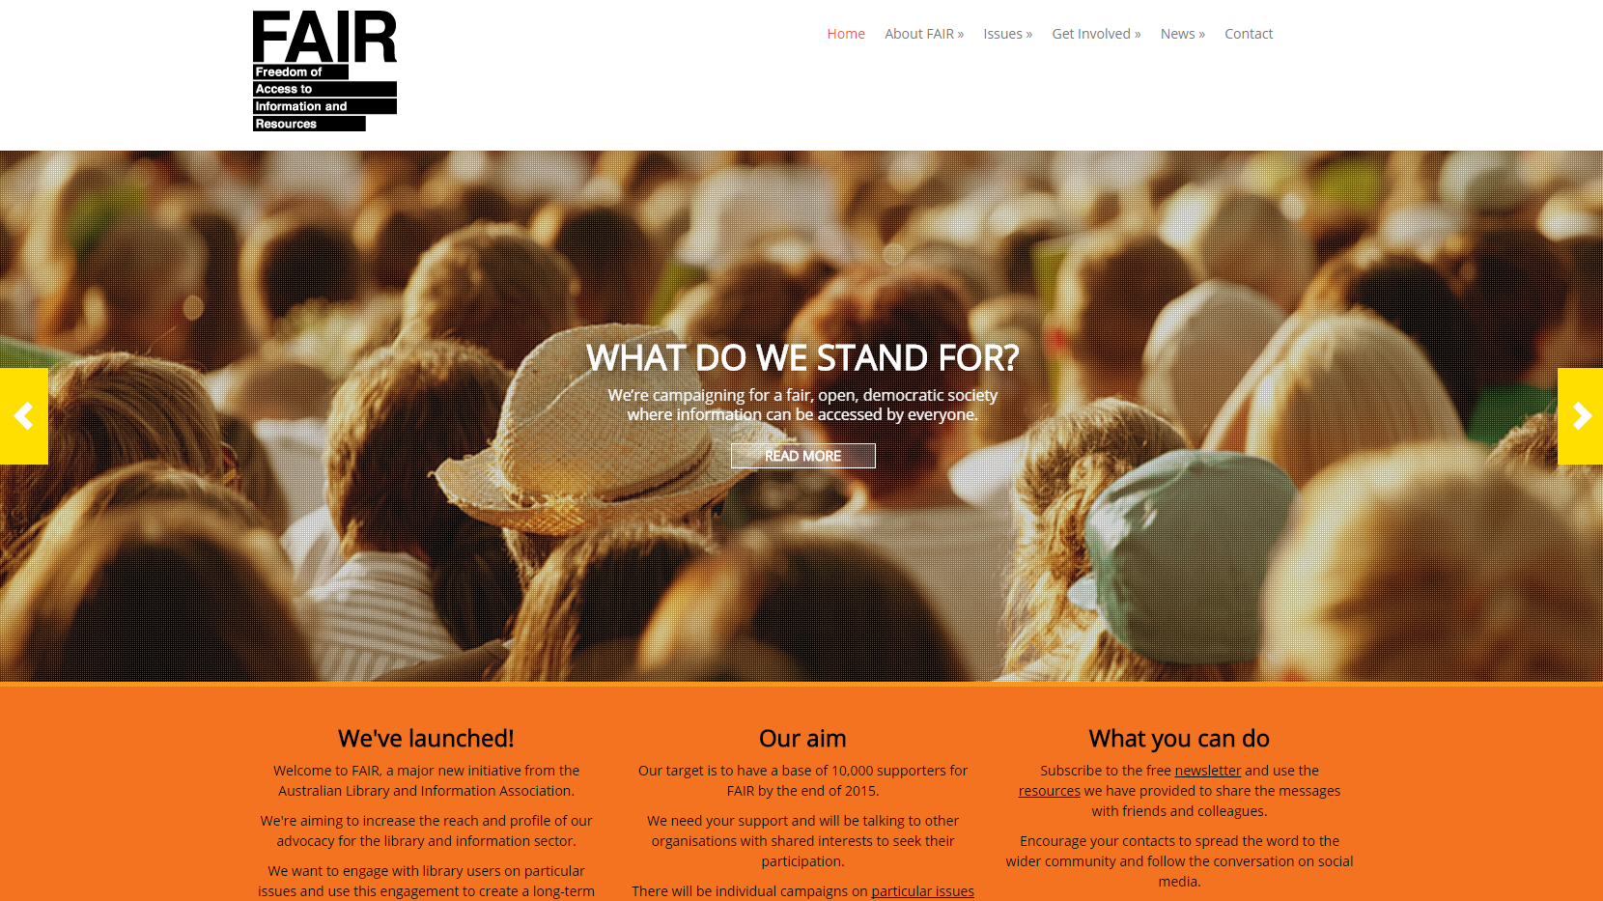

Slide 24

Find out more:
Talk to the ALIA team
Sign up to the newsletter online https://fair.alia.org.au
@joinFAIR #FAIR
facebook.com/joinFAIR

